Slide 1
ITSA線上程式競賽基礎題目
#6~10

Slide 2
題目6. 季節判定
https://e-tutor.itsa.org.tw/e-Tutor/mod/programming/view.php?id=30754
運算思維: (課堂講解)
程式碼說明: (課堂講解)

Slide 3
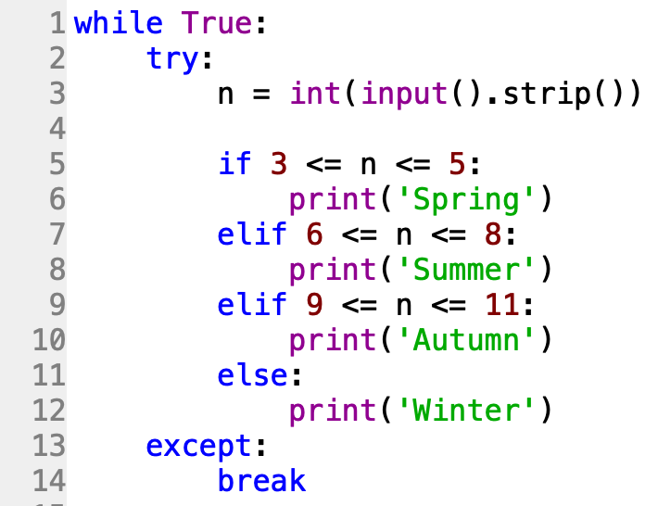

Slide 4
題目7. 複數運算
https://e-tutor.itsa.org.tw/e-Tutor/mod/programming/view.php?id=30755
運算思維: (課堂講解)
程式碼說明: (課堂講解)

Slide 5
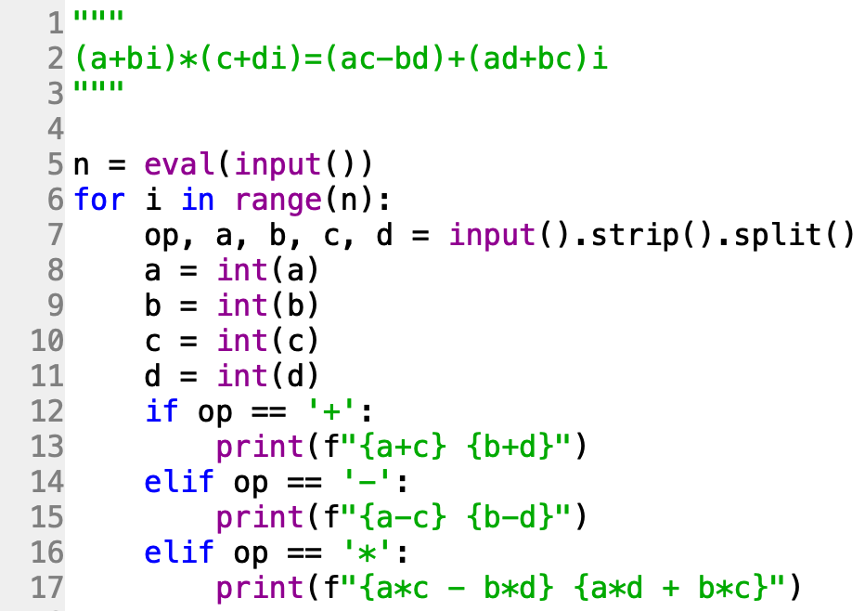

Slide 6
題目8. 質數判別
https://e-tutor.itsa.org.tw/e-Tutor/mod/programming/view.php?id=30752
運算思維: (課堂講解)
程式碼說明: (課堂講解)

Slide 7
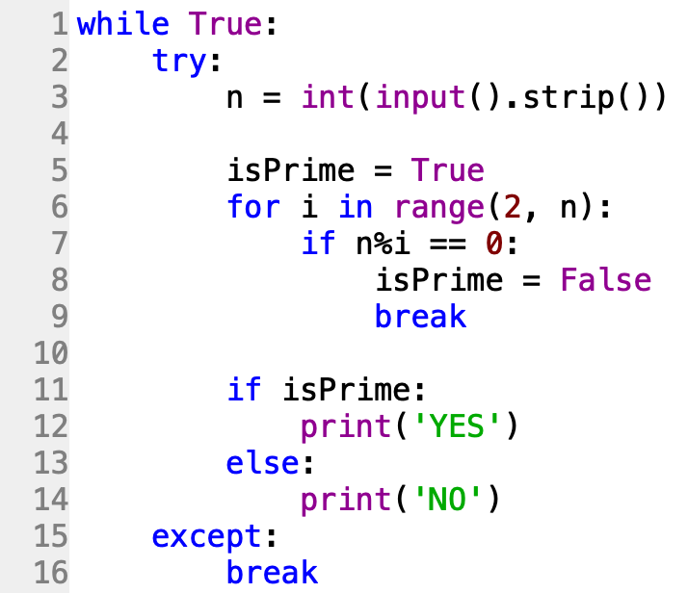
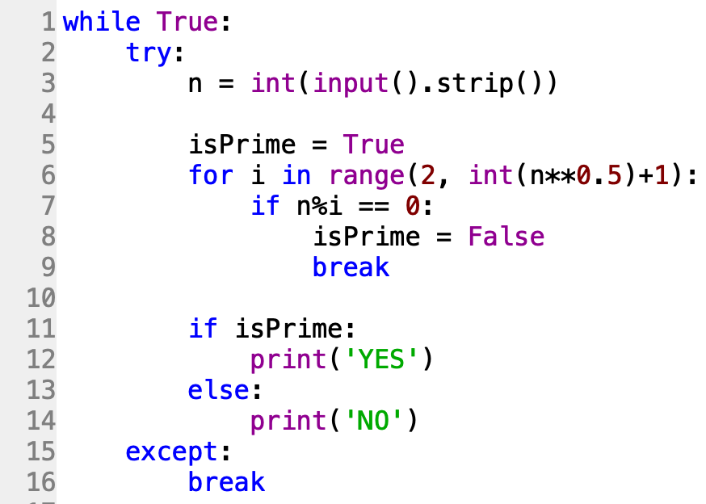
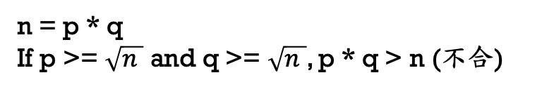
n = p * q
If p >= $\sqrt{n }$ and q >= $\sqrt{n }$, p * q > n (不合)

Slide 8
題目9. 計算正整數被3整除之數值之總和
https://e-tutor.itsa.org.tw/e-Tutor/mod/programming/view.php?id=30751
運算思維: (課堂講解)
程式碼說明: (課堂講解)

Slide 9
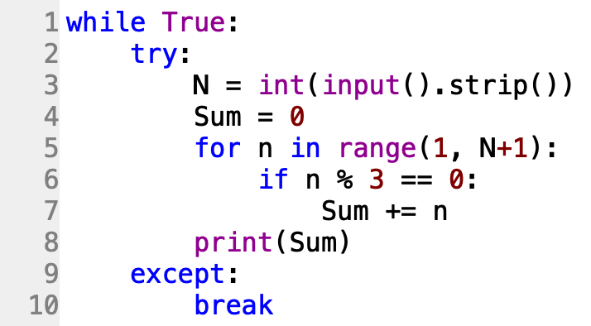
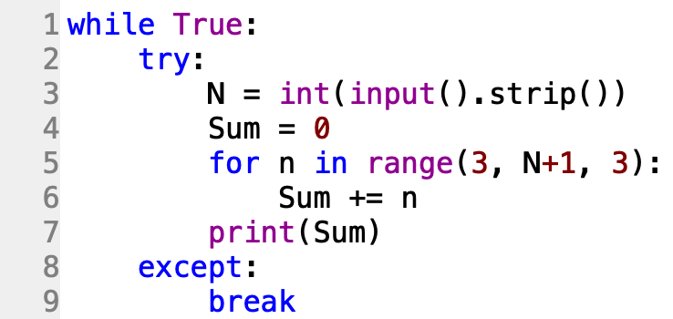

Slide 10
題目10. 輾轉相除法
https://e-tutor.itsa.org.tw/e-Tutor/mod/programming/view.php?id=30757
運算思維: (課堂講解)
程式碼說明: (課堂講解)

Slide 11
Greatest Common Divisor
gcd(a+b, b) = gcd(a, b)
Example:
a = 45
b = 27
45 / 27 = 1 … 18
27 / 18 = 1 … 9
18 / 9 = 2 … 0
45
27
18
18
9
9
9
https://zh.wikipedia.org/wiki/%E8%BC%BE%E8%BD%89%E7%9B%B8%E9%99%A4%E6%B3%95

Slide 12
